Slide 1
Computer Organization تنظيم الحاسوب
Chapter 2
Dr. Mahmoud Masadeh

Slide 2
Instructions: Language of the Computer

Slide 3
2.1 Introduction
To command a computer’s hardware, you must speak its language.
The words of a computer’s language are called instructions, and its vocabulary is called an instruction set.
We will see the instruction set of a real computer, both in the form written by people and in the form read by the computer.
Chapter 3 explain the hardware for arithmetic and the representation of floating-point numbers.
The chosen instruction set is RISC-V, which was originally developed at University of California (UC), Berkeley starting in 2010.

Slide 4
Introduction
Besides RISC-V, two other popular instruction sets:
MIPS is an elegant example of the instruction sets designed since the 1980s. In several respects, RISC-V follows a similar design.
The Intel x86 originated in the 1970s, but still today powers both the PC and the Cloud of the post-PC era.
Different instruction sets are similar because:
All computers are constructed from hardware technologies based on similar underlying principles.
There are a few basic operations that all computers must provide.
Computer designers have a common goal:
Find a language that makes it easy to build the hardware and the compiler while maximizing performance and minimizing cost and energy.

Slide 5
Introduction
For the instructions, we will show:
How it is represented in hardware
Its relationship with high-level programming languages.
Stored-program concept: The idea that instructions and data of many types can be stored in memory as numbers and thus be easy to change, leading to the stored-program computer.
Previous computers had their program instructions determined by the wiring of the machine.

Slide 6
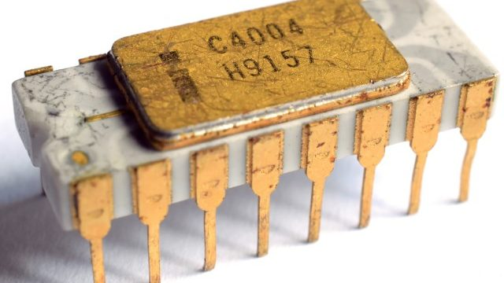
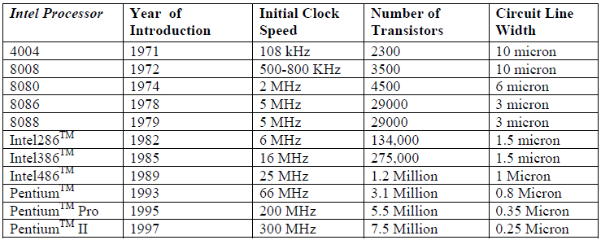
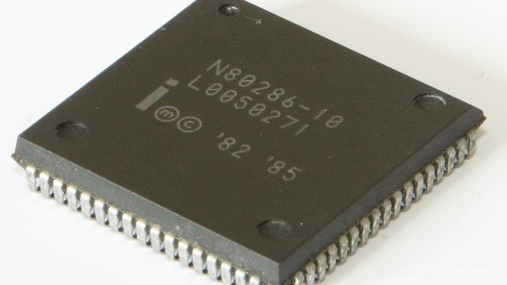
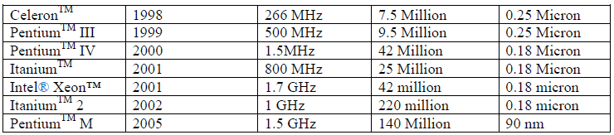
The development history of Intel family of processors

Slide 7
2.2 Operations of the Computer Hardware
Every computer must be able to perform arithmetic.
The RISC-V assembly language notation instructs a computer to add the two variables b and c and to put their sum in a.
Each RISC-V arithmetic instruction performs only one operation and must always have exactly three variables.
Suppose we want to place the sum of four variables b, c, d, and e into variable a. (a ← b+c+d+e)

Slide 8
Operations of the Computer Hardware
The natural number of operands for an operation like addition is three: the two numbers being added together and a place to put the sum.
Requiring every instruction to have exactly three operands, no more and no less, conforms to the philosophy of keeping the hardware simple.
Hardware for a variable number of operands is more complicated than hardware for a fixed number.
Design Principle 1: Simplicity favors regularity.

Slide 9
RISC-V assembly language /Arithmetic/ Data transfer

Slide 10
RISC-V assembly language /logical/ Shift

Slide 11
RISC-V assembly language /branch

Slide 12
Compiling Two C Assignment Statements into RISC-V

Slide 13
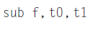
Compiling a Complex C Assignment into RISC-V

Slide 14
2.3 Operands of the Computer Hardware
The operands of arithmetic instructions must be from a limited number of special locations built directly in hardware called registers.
The size of a register in the RISC-V architecture is 64 bits.
Word: A natural unit of access in a computer, usually a group of 32 bits.
Doubleword: Another natural unit of access in a computer, usually a group of 64 bits; corresponds to the size of a register in the RISC-V architecture.
The three operands of RISC-V arithmetic instructions must each be chosen from one of the 32 64-bit registers.
Design Principle 2: Smaller is faster.

Slide 15
RISC-V operands

Slide 16
Operands of the Computer Hardware
Why only 32 registers:
A very large number of registers may increase the clock cycle time simply because it takes electronic signals longer when they must travel farther.
It has an effect on the instruction format

Slide 17
Compiling a C Assignment Using Registers

Slide 18
Memory Operands
Programming languages have simple variables that contain single data elements, as in previous examples, but they also have more complex data structures—arrays and structures.
Q1: How can a computer represent and access such large structures?
The processor can keep only a small amount of data in registers, but computer memory contains billions of data elements.
Arithmetic operations occur only on registers in RISC-V instructions.
Data transfer instruction: A command that moves data between memory and registers.
Address: A value used to delineate the location of a specific data element within a memory array.

Slide 19
Memory Operands
The data transfer instruction that copies data from memory to a register is traditionally called load.
The real RISC-V name for this instruction is ld, standing for load doubleword.
Memory is just a large, single-dimensional array, with the address acting as the index to that array, starting at 0

Slide 20
Compiling an Assignment When an Operand Is in Memory
Computers

Slide 21
Memory Operands
The compiler associate variables with registers.
The compiler allocates data structures, e.g., arrays and structures, to locations in memory.
Then, the compiler can place the proper starting address into the data transfer instructions.
8-bit bytes are useful in many programs.
Virtually, all architectures today address individual bytes.
Therefore, the address of a doubleword matches the address of one of the 8 bytes within the doubleword.
The addresses of sequential doublewords differ by 8.

Slide 22
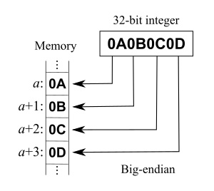
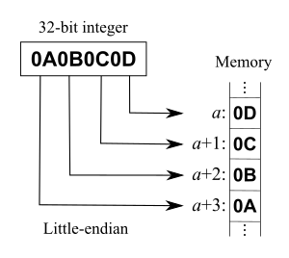
Memory Operands - Endianness
Computers divide into those that use the address of the leftmost or “big end” byte as the doubleword address versus those that use the rightmost or “little end” byte.
RISC-V belongs to the latter camp, referred to as little-endian.

Slide 23
Memory Operands - store
Store: This instruction copies data from a register to memory.
The actual RISC-V name is sd, standing for store doubleword.

Slide 24
Compiling Using Load and Store
Computers

Slide 25
Hardware/ Software Interface
When variables are more than registers, the compiler tries to keep the most frequently used variables in registers and places the rest in memory.
The process of putting less frequently used variables (or those needed later) into memory is called spilling registers.
A RISC-V arithmetic instruction can read two registers, operate on them, and write the result.
A RISC-V data transfer instruction only reads one operand or writes one operand, without operating on it.

Slide 26
Constant or Immediate Operands
More than half of the RISC-V arithmetic instructions have a constant as an operand when running the SPEC CPU2006 benchmarks.
For example, incrementing an index to point to the next element of an array requires using a constant in an operation.
add immediate or addi
By including constants inside arithmetic instructions, operations are much faster and use less energy than if constants were loaded from memory.
Register x0 to be hard-wired to the value zero which simplify the instruction set by offering useful variations.
We can negate the value in a register by using the sub instruction with zero for the first operand. sub x1, x0, x1 / 0-X=-X

Slide 27
Compiling Using Load and Store
Elaboration: Although the RISC-V registers in this book are 64 bits wide, the RISC-V architects conceived multiple variants of the ISA.
In addition to this variant, known as RV64, a variant named RV32 has 32-bit registers, whose reduced cost make RV32 better suited to very low-cost processors.

Slide 28
2.4 Signed and Unsigned Numbers
The drawing above shows the numbering of bits within a RISC-V doubleword and the placement of the number 1011_{two}, (which we split in half to fit on the page of the book):
Least significant bit: The rightmost bit in an RISC-V doubleword.
Most significant bit: The leftmost bit in an RISC-V doubleword.
It’s up to the programming language, the operating system, and the program to determine what to do if overflow occurs.

Slide 29
Signed and Unsigned Numbers
We need a representation that distinguishes the positive numbers from the negative.
The most obvious solution is to add a separate sign, which conveniently can be represented in a single bit; the name for this representation is sign and magnitude.
it’s not obvious where to put the sign bit. To the right? To the left?
Adders for sign and magnitude may need an extra step to set the sign because we can’t know in advance what the proper sign will be.
A separate sign bit means that sign and magnitude has both a positive and a negative zero.
Thus, sign and magnitude representation was soon abandoned

Slide 30

Two’s complement

Slide 31
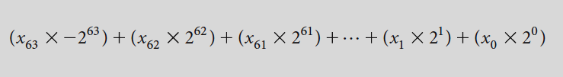
Two’s complement
All negative numbers have a 1 in the most significant bit.
Thus, hardware needs to test only this bit to see if a number is positive or negative.
This bit is often called the sign bit.
By recognizing the role of the sign bit, we can represent positive and negative 64-bit numbers in terms of the bit value times a power of 2:

Slide 32
Two’s complement
Signed load: Copy the sign repeatedly to fill the rest of the register. Called, sign extension.
Unsigned loads: Fill with 0s to the left of the data, since the number represented by the bit pattern is unsigned.
We need to represent both positive and negative integers within a computer, and although there are pros and cons to any option, the agreed choice since 1965 has been two’s complement.

Slide 33
2.5 Representing Instructions in the Computer
There is a difference between the way humans instruct computers and the way computers see instructions.
Each piece of an instruction can be considered as an individual number and placing these numbers side by side forms the instruction.
The 32 registers of RISC-V are just referred to by their number, from 0 to 31.

Slide 34
Translating a RISC-V Assembly Instruction into a Machine Instruction

Slide 36
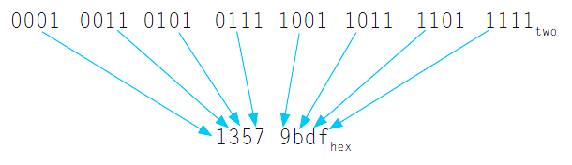
Memory Operands
Instruction format: A form of representation of an instruction composed of fields of binary numbers.
Machine language: Binary representation used for communication within a computer system.

Slide 37
RISC-V Fields
R-type (for register)

Slide 38
RISC-V Fields
I-type is used by arithmetic operands with one constant operand, including addi, and by load instructions.

Slide 39
RISC-V Fields
There is a specific format for the store doubleword instruction, sd, which needs two source registers (for the base address and the store data) and an immediate for the address offset.
The 12-bit immediate in the S-type format is split into two fields, which supply the lower 5 bits and upper 7 bits.
The RISC-V architects chose this design because it keeps the rs1 and rs2 fields in the same place in all instruction formats.
Keeping the instruction formats as similar as possible reduces hardware complexity.
The opcode and funct3 fields are the same size in all locations, and they are always in the same place.

Slide 40
RISC-V instruction encoding

Slide 41
Translating RISC-V Assembly Language into Machine Language
a

Slide 42
RISC-V Fields
Elaboration: Although RISC-V has both add and sub instructions, it does not have a subi counterpart to addi. This is because the immediate field represents a two’s complement integer, so addi can be used to subtract constants.

Slide 43
The BIG Picture

Slide 44
Check Yourself
What RISC-V instruction does this represent? Choose from one of the four options below.

Slide 45
2.6 Logical Operations
Logical operations allow to access/check specific bits of the data

Slide 46
Logical Operations
Shifts: They move all the bits in a doubleword to the left or right, filling the emptied bits with 0s.
The dual of a shift left is a shift right.
shift left logical immediate (slli). shift right logical immediate (srli).
These shift instructions use the I-type format. Since it isn’t useful to shift a 64-bit register by more than 63 bits, only the lower 6 bits of the I-type format’s 12-bit immediate are actually used.
The remaining 6 bits are repurposed as an additional opcode field, funct6.

Slide 47
Logical Operations
shift right arithmetic (srai), is similar to srli.
srai fills the vacated bits on the left with copies of the old sign bit.
AND: A logical bit-by-bit operation with two operands that calculates a 1 only if there is a 1 in both operands.
OR: A logical bit-by-bit operation with two operands that calculates a 1 if there is a 1 in either operand.
NOT: A logical bit-by-bit operation with one operand that inverts the bits.
XOR: A logical bit-by-bit operation with two operands that calculates a 1 only if the values are different in the two operands

Slide 48
Logical Operations
AND can apply a bit pattern to a set of bits to force 0s where there is a 0 in the bit pattern.
Such a bit pattern in conjunction with AND is traditionally called a mask, since the mask “conceals” some bits.
AND immediate (andi)
OR immediate (ori)
XOR immediate (xori)

Slide 49
2.7 Instructions for Making Decisions
What distinguishes a computer from a simple calculator is its ability to make decisions.
Decision making is commonly represented in programming languages using the if statement, sometimes combined with go to statements and labels.
beq stands for branch if equal.
bne stands for branch if not equal.
conditional branch: An instruction that tests a value and that allows for a subsequent transfer of control to a new address in the program based on the outcome of the test.

Slide 50
Compiling if-then-else into Conditional Branches
Unconditional branch

Slide 51
Loops
Decisions are important both for:
Choosing between two alternatives (found in if statements)
Iterating a computation (found in loops).
The same assembly instructions are the building blocks for both cases.
The test for equality or inequality is probably the most popular test, but there are many other relationships between two numbers.
For loop may want to test to see if the index variable is less than 0.
The full set of comparisons is
less than (<), less than or equal (≤)
greater than (>), greater than or equal (≥)
equal (=), and not equal (≠)

Slide 52
Compiling a while Loop in C
The first step is to load save[i] into a temporary register.
Before that, we need to have its address.
Before we can add i to the base of array save to form the address, we must multiply the index i by 8 due to the byte addressing issue.

Slide 53
More Conditional Operations
A basic block is a sequence of instructions with
No embedded branches (except at end)
No branch targets (except at beginning)
Branch if less than (blt): branch if the value in rs1 is less than the value in rs2.
Branch if greater than or equal (bge): branch if the value in rs1 is at least the value in rs2.
if (a > b) a += 1;
a in x22, b in x23
bge x23, x22, Exit // Exit/branch if b >= a
addi x22, x22, 1
Exit:
Branch if less than, unsigned (bltu)
Branch if greater than or equal, unsigned (bgeu)

Slide 54
More Conditional Operations
An alternative is to set a register based upon the result of the comparison, then branch on the value in that temporary register with the beq or bne instructions.
This approach, used by the MIPS instruction set,
can make the processor datapath slightly simpler,
but it takes more instructions to express a program.

Slide 55
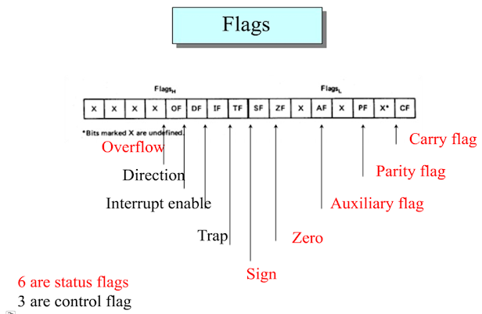
More Conditional Operations
Another alternative, used by ARM’s instruction sets, is to keep extra bits that record what occurred during an instruction.
These additional bits, called condition codes or flags, indicate, for example, if the result of an arithmetic operation was negative, or zero, or resulted in overflow.
Then, conditional branches use combinations of these condition codes to perform the desired test.
One downside to condition codes is that:
if many instructions always set them, it will
create dependencies that will make it difficult
for pipelined execution

Slide 56
Signed vs. Unsigned
Signed comparison: blt, bge
Unsigned comparison: bltu, bgeu
Example
x22 = 1111 1111 1111 1111 1111 1111 1111 1111
x23 = 0000 0000 0000 0000 0000 0000 0000 0001
x22 < x23 // signed
–1 < +1
x22 > x23 // unsigned
+4,294,967,295 > +1

Slide 57
Bounds Check Shortcut

Slide 58
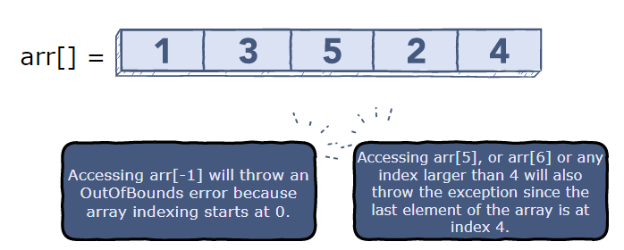
Bounds Check Shortcut
The ArrayIndexOutOfBounds exception is thrown if a program tries to access an array index that is negative, greater than, or equal to the length of the array.

Slide 59
Case/Switch Statement
Most programming languages have a case or switch statement that allows the programmer to select one of many alternatives depending on a single value.
The simplest way to implement switch is via a sequence of conditional tests, turning the switch statement into a chain of if-then-else statements.
Sometimes the alternatives may be encoded as a table of addresses of alternative instruction sequences, called a branch address table or branch table/ jump table, and the program needs only to index into the table and then branch to the appropriate sequence.

Slide 60
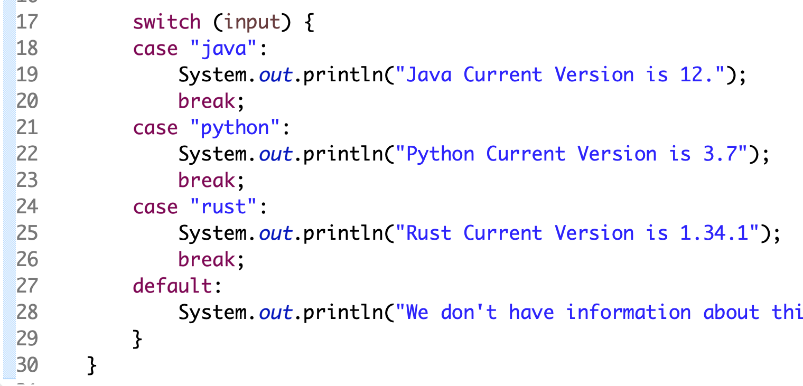
Case/Switch Statement
indirect jump instruction, which performs an unconditional branch to the address specified in a register.
Jump-and-link register instruction (jalr) serves this purpose. We’ll see an even more popular use of this versatile instruction in the next section.

Slide 61
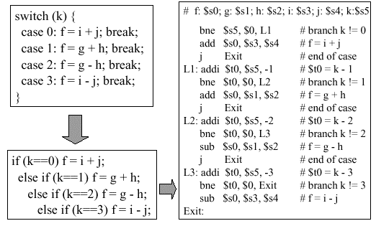
Case/Switch Statement (MIPS)

Slide 62
Check Yourself

Slide 63
2.8 Procedure Calling
Procedure: A stored subroutine/function that performs a specific task based on the parameters with which it is provided.
In the execution of a procedure, the program must follow these six steps:
Put parameters in a place where the procedure can access them (registers x10 to x17).
Transfer control to the procedure.
Acquire the storage resources needed for the procedure.
Perform the desired task.
Put the result value in a place where the calling program can access it.
Return control to the point of origin, since a procedure can be called from several points in a program (address in x1).

Slide 64
Procedure Call Instructions
RISC-V software follows the following convention for procedure calling in allocating its 32 registers:
x10–x17: eight parameter registers in which to pass parameters or return values.
x1: one return address register to return to the point of origin.
jump-and-link instruction An instruction that branches to an address and simultaneously saves the address of the following instruction in a register (usually x1 in RISC-V).
jal x1, ProcAddr // jump to ProcAddr and write return address to x1
Return address A link to the calling site that allows a procedure to return to the proper address; in RISC-V it is stored in register x1.

Slide 65
Procedure Call Instructions
To support the return from a procedure, RISC-V use an indirect jump, like the jump-and-link register (jalr) to help with case statements:
jalr x0, 0(x1)
The jalr instruction branches to the address stored in register x1—which is just what we want / Use x0 as rd (x0 cannot be changed).
Thus, the calling program, or caller, puts the parameter values in x10–x17 and uses jal x1, X to branch to procedure X.
Caller The program that instigates/trigger a procedure and provides the necessary parameter values.
The callee then performs the calculations, places the results in the same parameter registers, and returns control to the caller using jalr x0, 0(x1).
Callee A procedure that executes a series of stored instructions based on parameters provided by the caller and then returns control to the caller.

Slide 66
Procedure Call Instructions
Program counter (PC)/Instruction address register: The register containing the address of the instruction in the program being executed.
The jal instruction actually saves PC + 4 in its designation register (usually x1) to link to the byte address of the following instruction to set up the procedure return

Slide 67
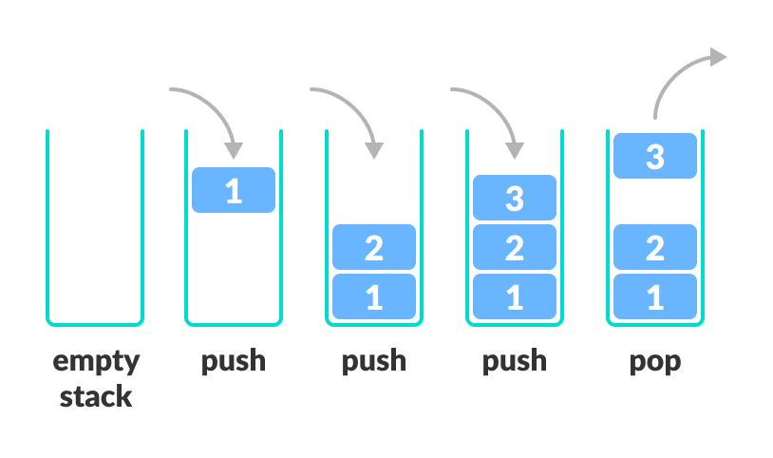
Procedure Call Instructions
Stack A data structure for spilling registers organized as a last-in-first-out (LIFO) queue.
Stack pointer A value denoting the most recently allocated address in a stack that shows where registers should be spilled or where old register values can be found. In RISC-V, it is register sp, or x2.
Push Add element to stack.
Pop Remove element from stack.

Slide 68
Compiling a C Procedure That Doesn’t Call Another Procedure
The compiled program starts with the label of the procedure: leaf_example:
The parameter variables g, h, i, and j correspond to the argument registers x10, x11, x12, and x13, and f corresponds to x20.
Save the registers used by the procedure, i.e., two temporary registers (x5 and x6) and x20. Thus, we need to save three registers: x5, x6, and x20.
We “push” the old values onto the stack by creating space for three doublewords (24 bytes) on the stack and then store them:

Slide 69
Compiling a C Procedure That Doesn’t Call Another Procedure

Slide 70
Supporting Procedures in Computer Hardware
To avoid saving and restoring a register whose value is never used, which might happen with a temporary register, RISC-V software separates 19 of the registers into two groups:
x5−x7 and x28−x31: temporary registers that are not preserved by the callee (called procedure) on a procedure call
x8−x9 and x18−x27: saved registers that must be preserved on a procedure call (if used, the callee saves and restores them)
This simple convention reduces register spilling.
In the example above, since the caller does not expect registers x5 and x6 to be preserved across a procedure call, we can drop two stores and two loads from the code.
We still must save and restore x20, since the callee must assume that the caller needs its value.
Procedures that do not call others are called leaf procedures.

Slide 71
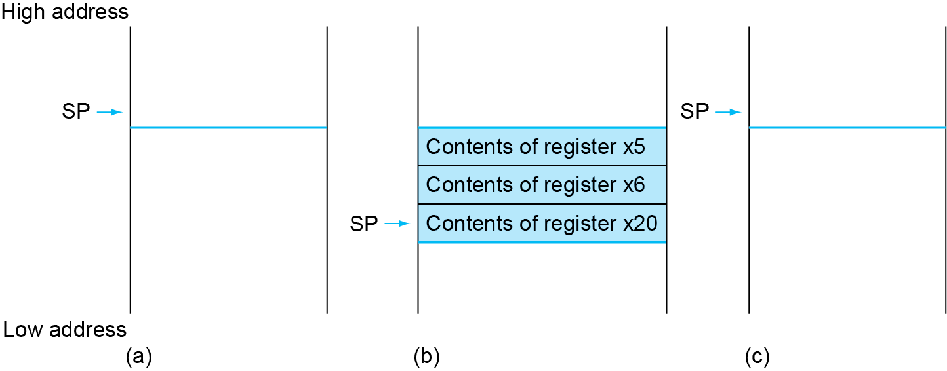
Local Data on the Stack

Slide 72
Register Usage
x5 – x7, x28 – x31: temporary registers
Not preserved by the callee
x8 – x9, x18 – x27: saved registers
If used, the callee saves and restores them

Slide 73
Non-Leaf Procedures
Procedures that call other procedures
For nested call, caller needs to save on the stack:
Its return address
Any arguments and temporaries needed after the call
Restore from the stack after the call

Slide 74
Non-Leaf Procedure Example …. We have other slides ☺
The parameter variable n corresponds to the argument register x10.
The compiled program starts with the label of the procedure.
Then, saves two registers on the stack, the return address and x10:
1
The next two instructions test whether n is less than 1, going to L1 if n ≥ 1.
If n < 1, fact returns 1 by putting 1 into a value register (it adds 1 to 0 and places that sum in x10).
Then, pops the two saved values off the stack and branches to the return address.
If n is not less than 1, the argument n is decremented and then fact is called again with the decremented value:
The next instruction is where fact returns; its result is in x10.
Now the old return address and old argument are restored, along with the stack pointer:
2
4
5
3

Slide 75
Non-Leaf Procedure Example
Next, argument register x10 gets the product of the old argument and the result of fact(n - 1), now in x6.
We assume a multiply instruction is available
The parameter variable n corresponds to the argument register x10.
The compiled program starts with the label of the procedure.
Then, saves two registers on the stack, the return address and x10:
6
1
Finally, fact branches again to the return address:
7
If n is not less than 1, the argument n is decremented and then fact is called again with the decremented value:
The next instruction is where fact returns; its result is in x10.
Now the old return address and old argument are restored, along with the stack pointer:
The next two instructions test whether n is less than 1, going to L1 if n ≥ 1.
If n < 1, fact returns 1 by putting 1 into a value register (it adds 1 to 0 and places that sum in x10).
Then, pops the two saved values off the stack and branches to the return address.
2
4
5
3

Slide 76
Non-Leaf Procedure Example
1
2
3
4
5
6
7

Slide 77
Hardware/Software Interface
A C variable is generally a location in storage, and its interpretation depends both on its type and storage class.
Example types include integers and characters.
C has two storage classes: automatic and static.
Automatic variables are local to a procedure and are discarded when the procedure exits.
Static variables exist across exits from and entries to procedures.
C variables declared outside all procedures are considered static, as are any variables declared using the keyword static. The rest are automatic.
To simplify access to static data, some RISC-V compilers reserve a register x3 for use as the global pointer, or gp.

Slide 78
Supporting Procedures in Computer Hardware
Name | Register Number | Usage
zero | x0 | Constant value 0
ra | x1 | Return address
sp | x2 | Stack pointer
gp | x3 | Global pointer
tp | x4 | Thread pointer
t0-2 | x5-7 | Temporaries
s0/fp | x8 | Saved register / Frame pointer
s1 | x9 | Saved register
a0-1 | x10-11 | Function arguments / return values
a2-7 | x12-17 | Function arguments
s2-11 | x18-27 | Saved registers
t3-6 | x28-31 | Temporaries
Table above summarizes what is preserved across a procedure call.
Several schemes preserve the stack, guaranteeing that the caller will get the same data back on a load from the stack as it stored onto the stack.
sp is itself preserved by the callee adding exactly the same amount that was subtracted from it; and the other registers are preserved by saving them on the stack and restoring them from there.

Slide 79
Allocating Space for New Data on the Stack
The stack is used to store variables that are local to the procedure but do not fit in registers, such as local arrays or structures.
The segment of the stack containing a procedure’s saved registers and local variables is called a procedure frame or activation record.
Some RISC-V compilers use a frame pointer fp, or register x8 to point to the first doubleword of the procedure frame .
We’ve been avoiding using fp by avoiding changes to sp within a procedure.
In our examples, the stack is adjusted only on entry to and exit from the procedure.

Slide 80
Allocating Space for New Data on the Heap
C programmers need space in memory for local variables to procedures, static variables, and for dynamic data structures.
Text segment: The segment of a UNIX object file that contains the machine language code for routines in the source file.
Arrays tend to be a fixed length and thus are a good match to the static data segment.
Data structures like linked lists tend to grow and shrink during their lifetimes. The segment for such data structures is traditionally called the heap, and it is placed next in memory
C allocates and frees space on the heap with explicit functions. malloc() allocates space on the heap and returns a pointer to it, and free() releases space on the heap to which the pointer points.
Forgetting to free space leads to a “memory leak,” which ultimately uses up so much memory that the operating system may crash.
Freeing space too early leads to “dangling pointers,” which can cause pointers to point to things that the program never intended.
Java uses automatic memory allocation and garbage collection just to avoid such bugs.

Slide 81
Register conventions for the RISC-V

Slide 82
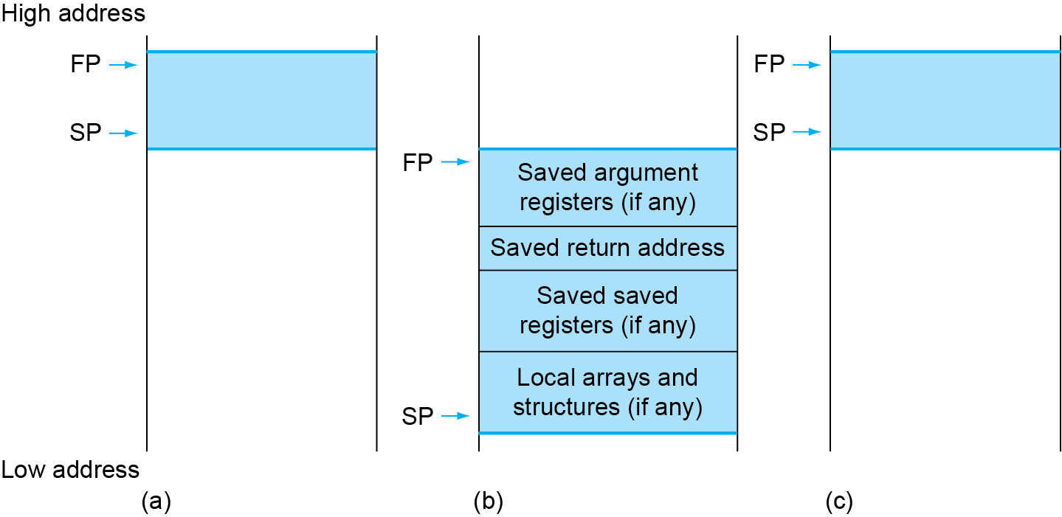
Local Data on the Stack
Local data allocated by callee
e.g., C automatic variables
Procedure frame (activation record)
Used by some compilers to manage stack storage

Slide 83
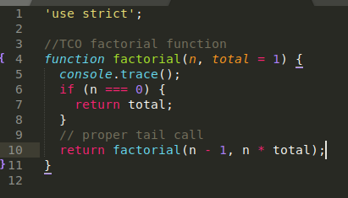
Elaboration
acc ← n +acc
n ← n - 1

Slide 84
2.9 Communicating with People
Computers were invented to process large amount of numbers.
After they became commercially viable, they were used to process text.
American Standard Code for Information Interchange (ASCII) is the representation that nearly everyone follows.
Each character is represented by 8-bit bytes.

Slide 85
ASCII versus Binary Numbers

Slide 86
Communicating with People
Load byte unsigned (lbu): loads a byte from memory, placing it in the rightmost 8 bits of a register.
Store byte (sb): takes a byte from the rightmost 8 bits of a register and writes it to memory.
We copy a byte with the sequence
lbu x12, 0(x10) // Read byte from source
sb x12, 0(x11) // Write byte to destination
Characters are normally combined into strings, which have a variable number of characters.
There are three choices for representing a string:
(1) the first position of the string is reserved to give the length of a string,
(2) an accompanying variable has the length of the string (as in a structure),
(3) the last position of a string is indicated by a character used to mark the end of a string (as in C language, terminating a string with a byte whose value is 0 (named null in ASCII)).
Mem ← Reg ← Mem
string str1 = "Hello";

Slide 87
Compiling a String Copy Procedure, Showing How to Use C Strings
3
size_t is the unsigned integer type of the result of the sizeof operator
4
5
1
6
2

Slide 88
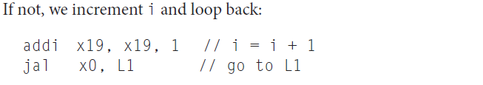
Compiling a String Copy Procedure, Showing How to Use C Strings
5
1
6
2
7
3
8
4

Slide 89
Communicating with People
Unicode is a universal encoding of the alphabets of most human languages.
Java uses Unicode for characters. By default, it uses 16 bits to represent a character.
The RISC-V instruction set has explicit instructions to load and store such 16-bit quantities, called halfwords.
Load half unsigned (lhu): loads a halfword from memory, placing it in the rightmost 16 bits of a register, filling the leftmost 48 bits with zeros.
load half (lh): treats the halfword as a signed number and thus sign-extends to fill the 48 leftmost bits of the register.
Store half (sh): takes a halfword from the rightmost 16 bits of a register and writes it to memory.
We copy a halfword with the sequence:
M[R[x11]] ← X19 ← M[R[x10]]

Slide 90
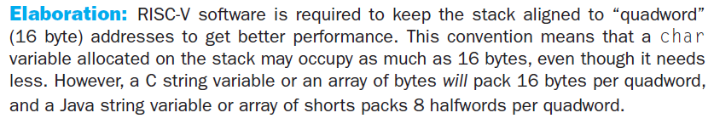
Communicating with People

Slide 91
Consider two different implementations of the same instruction set architecture.
The instructions can be divided into four classes according to their CPI (classes A, B, C, and D).
P1 with a clock rate of 2.5 GHz and CPIs of 5, 2, 3, and 3, and P2 with a clock rate of 3 GHz and CPIs of 2, 2, 2, and 2.
Given a program with a dynamic instruction count of 1.0E6 instructions divided into classes as follows: 10% class A, 20% class B, 50% class C, and 20% class D.
What is the global CPI for each implementation?

